Slide 1

DEPARTMENT OF INFORMATION TECHNOLOGY
BATCH NO – A10
PHASE-1 FINAL REVIEW
BIOMETRIC MIRROR- EXPLORING ATTITUDE TOWARDS FACIAL AND OBJECT ANALYSIS
DOMAIN: DEEP LEARNING
PROJECT GUIDE:
DR.A.MEIAPPANE,
PROFESSOR ,
DEPARTMENT OF IT
PRESENTED BY,
P. BHARATHI (19TH0411)
R. GAJALAKSHMI (19TH0422)
S. JAYAPRIYA (19TH0431)
1

Slide 2
ABSTRACT
INTRODUCTION
OBJECTIVE & SCOPE OF PROPOSED WORK
LITERATURE REVIEW
EXISTING SYSTEM
PROBLEM STATEMENT
PROPOSED SYSTEM
PROPOSED ARCHITECTURE DIAGRAM
MODULE AND MODULE DESCRIPTION
CONCLUSION
REFERENCES
CONTENT
2

Slide 3
ABSTRACT
Now-a-days with the continued development of artificial intelligence facial emotion recognition has become more popular. The emotion recognition plays a major role in interaction technology. In interaction technology the verbal components only play a one third of communication and the non-verbal components plays a two third of communication. A facial emotion recognition (FER) method is used for detecting facial expressions. Facial expression plays a major role in expressing what a person feels and it expresses inner feeling and his or her mental situation or human perspective. Deep neural network through feature learning perform data representation well and have gained many successes in learning and complex problems, many studies have been done on the application of deep neural networks to face recognition and many successes has been achieved. This paper aims to identify basic human emotions with the combination of gender classification and age estimation. The facial emotions such as happy, sad, angry, fear, surprised, neutral emotions are considered as basic emotions. We have chosen main dataset which is namely JAFFE and YALE.
3

Slide 4
INTRODUCTION
In this Project, we explore using Deep Neural Network and device getting to know.
Facial Expression recognition algorithm is advanced to analyze a various type of human expressions- satisfied, unhappy, indignant and amazed.
Object detection algorithm is advanced to analyze a various type behind Objects along with Human Face.
JAFFE and Yale database is used for train the database. This facial features popularity device is observed to be 98% correct in studying the human emotion.
Facial expression recognition is a technique done via human beings or computers, which includes finding faces in the scene called face detection.
4

Slide 5
OBJECTIVE OF PROPOSED SYSTEM
The objective of face emotion recognition using Deep Neural Networks (DNN) is to train a model that can accurately recognize human emotions based on facial expressions.
This is a task in the field of computer vision and is useful for a wide range of applications, including but not limited to, human-computer interaction, marketing research, and psychology research.
The DNN model is trained using a dataset of labeled facial expressions, which may include a range of emotions such as happiness, sadness, anger, surprise, fear, and disgust.
The model uses the images of the face as input and learns to recognize patterns that correspond to different emotions. Once trained, the model can be used to classify the emotions of a new image of a face.
5

Slide 6
The objective of object detection is to develop an system that can automatically identify and locate objects of interest in an image or video.
Object detection in DNNs typically involves training a model to classify objects and predict their bounding boxes in an image or video.
Object detection is a critical task in computer vision and has many real-world applications such as autonomous driving, video surveillance, robotics, and medical imaging.
Both face emotion recognition and object detection are challenging tasks in computer vision that require sophisticated algorithms and deep learning models. These tasks involve processing large amounts of image and video data and require the ability to accurately detect and classify complex patterns in the data.
6

Slide 7
SCOPE
The scope of face emotion recognition and object detection using deep neural networks (DNNs) encompasses various domain. Here are some potential areas of scope:
Security and surveillance: Face emotion recognition and object detection can be used in security and surveillance applications to detect and classify suspicious activities or people.
Automotive: Object detection can be used in autonomous vehicles to detect and avoid obstacles, while face emotion recognition can be used to improve driver safety and comfort.
Healthcare: Face emotion recognition can be used to detect patient distress or pain, while object detection can be used to identify and track medical equipment and supplies.
Retail: Object detection can be used in retail environments to track inventory and detect shoplifting, while face emotion recognition can be used to analyze customer behavior and improve marketing strategies.
Entertainment: Face emotion recognition can be used in gaming and virtual reality applications to create more realistic and engaging experiences.
Human resources: Face emotion recognition can be used in recruitment and hiring to analyze candidate behavior and identify the best fit for a given role.
Overall, the scope of face emotion recognition and object detection using DNNs is quite broad, and the technology can be applied in many different fields to improve efficiency, safety, and user experience.
7

Slide 8
LITERATURE SURVEY
SI.NO | TITLE OF THE PAPER | DESCRIPTION | LIMITATIONS
1 | Biometric Mirror: Exploring values and Attitudes towards Facial Analysis and Automated Decision making. Author: Neils Wouters, Ryan Kelly. Year: 2019 Paper: ResearchGate Journal | The interactive application distinguished demographic and psychometric information from people’s facial photos and presented speculative scenarios with potential consequences based on their results | The main problem with using facial recognition biometrics to login is that the user needs to remove their face mask. Many people don't like the idea o having to remove face masks to access systems in a place that likely requires the use of face masks.
8

Slide 9
SI.NO | TITLE OF THE PAPER | DESCRIPTION | LIMITATIONS
2 | Facial Emotion Detection Using Deep Learning Author:Akriti Jaiswal, A. Krishnama Raju, Suman Deb Year: 2020 Paper: IEEE Conferernce | Deep learning (DL) based emotion detection gives performance better than traditional methods with image processing. This paper presents the design of an artificial intelligence (AI) system capable of emotion detection through facial expressions.The performance of the proposed method is evaluated using two datasets Facial emotion recognition challenge (FERC-2013) and Japanesse female facial emotion (JAFFE). The accuracies achieved with proposed model are 70.14 and 98.65 percentage for FERC- 2013 and JAFFE datasets respectively. | Mimics could be to some extent controlled by humans and therefore the recognition results might be intentionally or unintentionally falsified. Disadvantages of face detection include huge storage requirements, vulnerable detection, and potential privacy issues.
9

Slide 10
SI.NO | TITLE OF THE PAPER | DESCRIPTION | LIMITATIONS
3 | Facial Expression Recognition Based Using Deep Neural Network Author: Junnan Li and Edmund Y. Lam Year:2015 Paper: IEEE Conference | Develop a technique using deep neural network for human facial expression recognition. Kernel PCA is applied to features before feeding them into the deep neural network that consists of 1 input layer, 2 hidden layers and a soft max classifier. It is demonstrated that the network generalizes to new images fairly successfully with an average accuracy rate of 96.8% for six emotions and 91.7% for seven emotions. In comparison with shallower neural network, the proposed deep network method can provide better recognition performance. | The disadvantages of using facial expressions to measure emotions are that most facial expression coding schemes rely on the FACS system traditionally used to classify only the six basic emotions, and are very labor-intensive if done by trained human coders rather than software.
10

Slide 11
SI.NO | TITLE OF THE PAPER | DESCRIPTION | LIMITATIONS
4 | Real Time Facial Expression Recognition Based On Deep Neural Network Author: T. Ambikadevi Amma, M. R. Sruthy,S. Divya,P. Renuka Year:2019 Paper: IJRESM Journal | A facial emotion recognition (FER) method is used for detecting facial expressions. This paper aims to identify basic human emotions with the combination of gender classification and age estimation. The facial emotions such as happy, sad, angry, fear, surprised, neutral emotions are considered as basic emotions. . | Poor Image Quality. The effectiveness of facial-recognition algorithms is influenced by the image quality. Small Image Sizes. Different Face Angles. Data Processing and Storage Issues.
11

Slide 12
SI.NO | TITLE OF THE PAPER | DESCRIPTION | LIMITATIONS
5 | Emotion Recognition using Deep Neural Network with Vectorized Facial Features Author: Guojun Yang, Jordi Saumell y Ortoneda and Jafar Saniie Year:2018 Paper: IEEE Conference | Emotion reveals valuable information regarding human communications. It is common to use facial expressions to express emotions during a conversation. The vectorized facial feature can be used to build an DNN (Deep Neural Network) for emotion recognition. Using the proposed vectorized facial feature, the DNN can predict emotions with 84.33% accuracy. Nevertheless, compared with CNNs (Convolutional Neural Network) with similar performance, training such DNN requires less time and data. | It is a challenge to make emotion available in different language Performance and results of the emotion sensing system depends on accuracy of the sensors such as cameras, thermal image sensors, facial recognition algorithm used and so on. Highly accurate system will be expensive due to use of costly components.
12

Slide 13
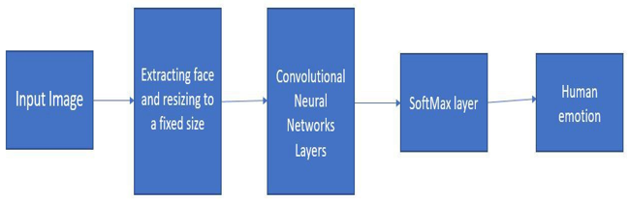
EXISTING SYSTEM
13

Slide 14
Here is a high-level overview of a typical architecture:
Input: The system takes an image or a video stream as input, which may be preprocessed to enhance image quality and remove noise.
Feature extraction: The input is fed through one or more convolutional layers to extract features from the image. These layers apply filters to the input, which help to identify edges, shapes, and patterns in the image.
Pooling: The output of the convolutional layers is typically down sampled using pooling layers, which reduce the dimensionality of the feature maps and help to avoid over fitting.
Soft max Layer: The use of the soft max layer in CNN-based face emotion recognition allows for probabilistic predictions, which can be useful in cases where there is uncertainty or ambiguity in the input. It also enables the use of standard classification metrics such as cross-entropy loss, which can be used to train the model to minimize prediction error.
Classification: The resulting feature maps are then flattened and fed into one or more fully connected layers for classification. These layers use the extracted features to classify the image as belonging to a particular emotion or object class.
Output: The system produces an output, which may include the class label or probability scores for each class.
14

Slide 15
PROBLEM STATEMENT
The existing system for this paper comprises facial emotion recognition using Convolutional Neural Networks which suffers from the following issues:
Limited accuracy: Although CNNs can achieve high accuracy in face emotion recognition and object detection, there may still be errors in the predictions. This can be due to several factors, such as variations in lighting, pose, and occlusions, as well as the complexity and variability of emotions.
Need for large datasets: CNNs require large, diverse datasets for training. Collecting and labeling large datasets for face emotion recognition and object detection can be time-consuming and expensive.
Limited flexibility: CNNs are designed to work with fixed-size inputs and are less flexible in terms of handling images with different sizes or aspect ratios. This may limit the applicability of the model to real-world scenarios where input images can vary widely in terms of size and aspect ratio.
To overcome the issues , we build a face emotion recognition system with the help of Deep Neural Networks(DNN) which results the output with the maximum accuracy and which is done with less time and data.
15

Slide 16
PROPOSED SYSTEM
The proposed system “Biometric mirror” has two different detection like face emotion detection and object detection. These detection finds the face emotion and object in real time with the help of an algorithm such as DNN with stemmer feature extraction and Adaptive block partition decision algorithm.
Facial features will be introduced to represent facial expression. The proposed facial feature model can not only reflect facial expressions correctly, it can also be used for DNN with high efficiency. To test the efficiency of such method, a DNN is trained to recognize some universal expressions.
Compared with more complicated neural network structures, such as CNNs (Convolutional Neural Network) , a DNN can be trained with less data, therefore, to be built quicker. To be more specific, with simpler inputs, a deep neural network can have a simpler structure, hence, can be trained with less data, and quicker.
16

Slide 17
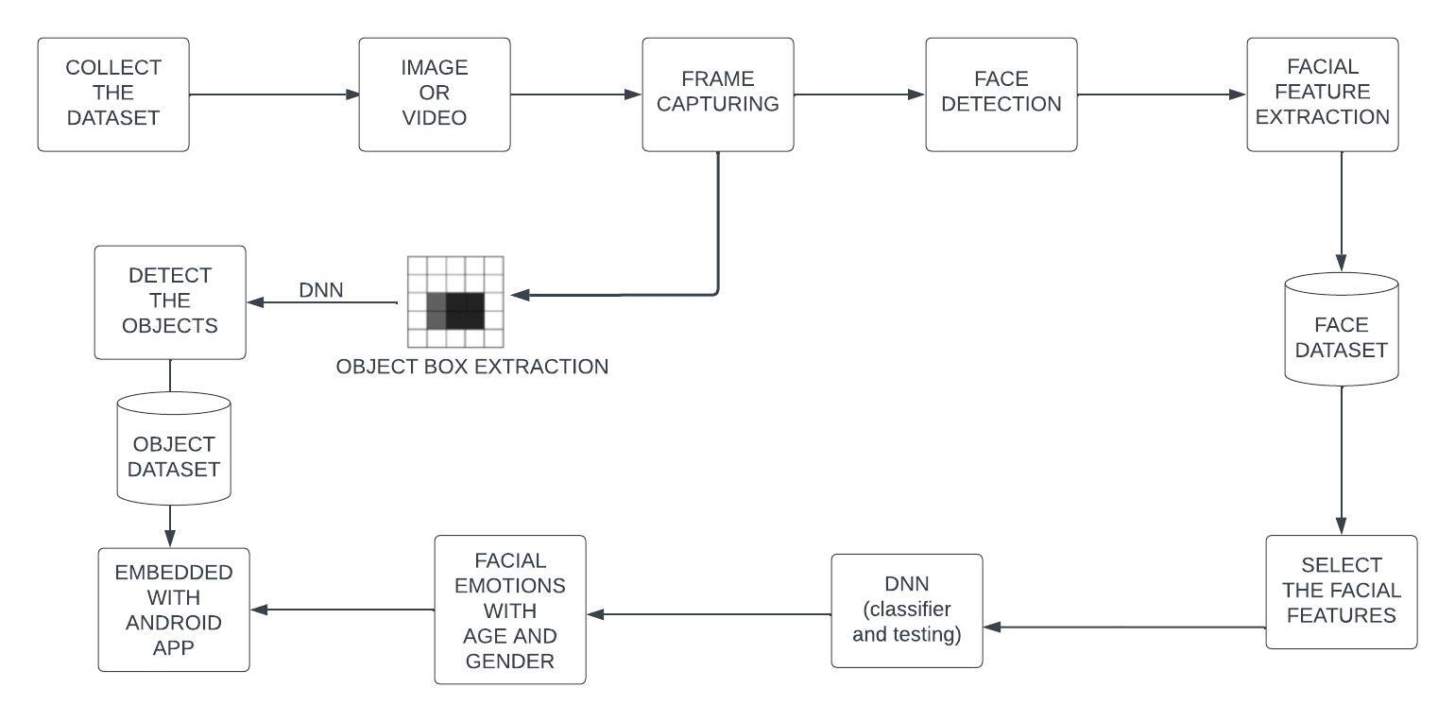
PROPOSED SYSTEM ARCHITECTURE
17

Slide 18
DESCRIPTION
Firstly, we collect the dataset of YOLO and JAFFE in the process of Face emotion recognition and object detection.
Then it Compare with input image or video ,it produce frame capturing.
Then frame capture analyze face detection using viola Jones Algorithm with having Face Feature Extractions to face datasets.
It will extracts the select facial feature using Adaboost Algorithm.
Next, we select the some facial features for DNN classifier and testing purposes using LDA then process, it will detect the face emotions with some characteristics(Age & gender).
In this output is embedded with Android Application and analyze object detection as using Captured Image work with Adaptive block partition and Face Emotic technique to detect the objects.
18

Slide 19
MODULES
MODULE 1: IMAGE ACQUISITION
MODULE 2: 2D TO 3D CONVERSION
MODULE 3: FACE DETECTION AND FUZZY DOWN-SAMPLING
MODULE 4: FEATURE EXTRACTION
MODULE 5: FEATURE SELECTION
MODULE 6: DEEP NEURAL NETWORK (DNN) CLASSIFIER
19

Slide 20
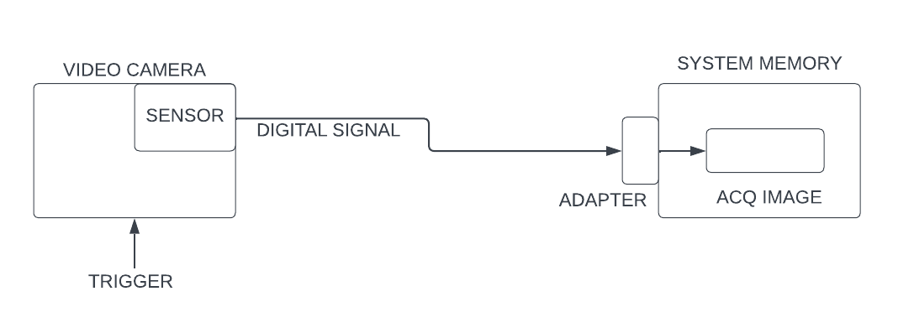
MODULE DESCRIPTION
MODULE 1: IMAGE ACQUISITION
Before any video or image processing can commence an image must be captured by a camera and converted into a manageable entity.
Image acquisition is the action of retrieving an image from a source, usually hardware systems like cameras, sensors, etc.
This is the process known as image acquisition.
20

Slide 21
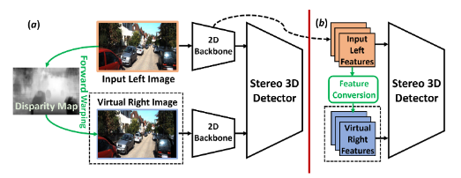
MODULE 2: 2D TO 3D CONVERSION
In this process we are converting the 2d coordinates image into 3d coordinates for better processing in the segmentation process.
The 3D coordinates of facial landmarks are more informative than their 2D counterparts and can provide additional depth information that can improve the accuracy of emotion recognition.
Rendering a second stereoscopic view from a monocular image sequence, which is also known as 2D/3D conversion, is a promising way to achieve high quality stereo motion pictures.
21

Slide 22
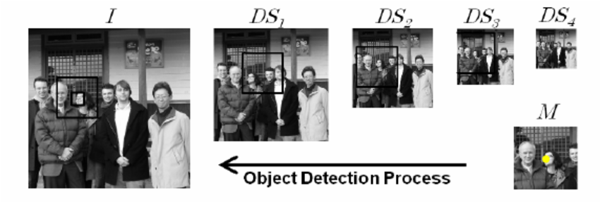
MODULE 3 : FACE DETECTION AND FUZZY DOWN SAMPLING
Face Detection component was implemented by Viola Jones.
Using the fuzzy down-sampling algorithm it is used to reduce the resolution of the input image. Fuzzy down-sampling preserves the important features of the image by selectively reducing the number of pixels in the image. This algorithm uses a fuzzy clustering technique to group the pixels into clusters and then selects the representative pixels from each cluster to form the down-sampled image.
Image is rescaled to 64 * 64 px by Fuzzy Down Sampling
22

Slide 23
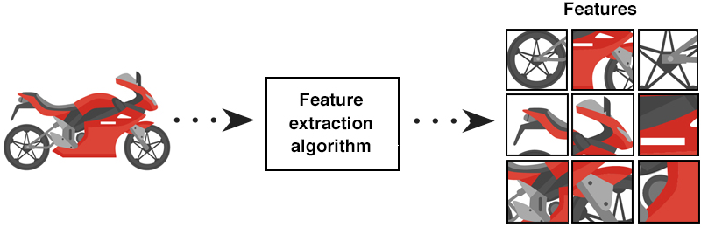
MODULE 4: FEATURE EXTRACTION
Feature extraction is a special form of dimensionality reduction.
Extract features from the face through the evaluation of their weights in different related domains. The feature extraction is a preprocessing stage of the knowledge discovery.
This preprocessing step aims at converting the face review features into a set of specific features and, at the same time, enriching their semantic characteristics
23

Slide 24
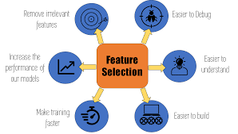
MODULE 5: FEATURE SELECTION
It involves selecting the most relevant and informative features from the available input data, which helps in improving the accuracy and performance of the model.
One approach is to use a pre-trained DNN to extract features from the input images, and then apply feature selection techniques such as PCA (Principal Component Analysis) or LDA (Linear Discriminant Analysis).
Feature selection is an important step in face emotion recognition using DNN, and can help in improving the accuracy and efficiency of the classification model.
Eg: Selects the most relevant part of face where the emotions can be classified.
24

Slide 25
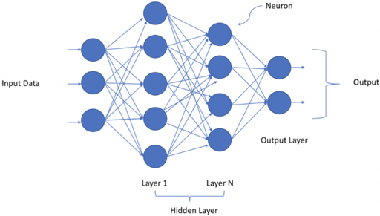
MODULE 6: DEEP NEURAL NETWORK (DNN) CLASSIFIER
Deep Neural Network (DNN) has recently achieved outstanding performance in a variety of computer vision tasks, including facial attribute classification.
The great success of classifying facial attributes with DNN often relies on a massive amount of labelled data. However, in real-world applications, labelled data are only provided for some commonly used attributes (such as age, gender); whereas, unlabelled data are available for other attributes (such as attraction, responsibility).
25

Slide 26
CONCLUSION
In this paper, we analysed Bio-metric Mirror, an interactive facial and object analysis application that presented users with a personalized, speculative scenario of Knowing themself psychologically. Deep Learning is an execution of Artificial Intelligence (AI). This study employs strengthen techniques. It enhance reputation price and execution time. The study involves Face Detection: Viola Jones Algorithm, Down Sampled: Fuzzy transform,Extracted characteristic: Ada Boost Technique, select characteristic: Stemmer Feature Wavelets decided on characteristic fed into DNN Classifier It is network Trained by sample database JAFFE and Yale. We found that users interpreted Biometric Mirror as a artifact that was capable of provoking reflection on the underlying concerns that are associated with facial analysis technology and automated decision-making.
26

Slide 27
REFERENCE
Yang, J. S. Y. Ortoneda and J. Saniie, "Emotion Recognition Using Deep Neural Network with Vectorized Facial Features," 2018 IEEE International Conference on Electro/Information Technology (EIT), Rochester, MI, USA, 2018, pp. 0318-0322.
Jaiswal, A. Krishnama Raju and S. Deb, "Facial Emotion Detection Using Deep Learning," 2020 International Conference for Emerging Technology (INCET), Belgaum, India, 2020, pp. 1-5
J. Li and E. Y. Lam, "Facial expression recognition using deep neural networks," 2015 IEEE International Conference on Imaging Systems and Techniques (IST), Macau, China, 2015, pp. 1-6.
Lee, H. Jung, C. H. Ahn, J. Seo, J. Kim and O. Kwon, "Real-time personalized facial expression recognition system based on deep learning," 2016 IEEE International Conference on Consumer Electronics (ICCE), Las Vegas, NV, USA, 2016, pp. 267-268,.
Do, LN., Yang, HJ., Nguyen, HD. et al. Deep neural network-based fusion model for emotion recognition using visual data. J Super comput 77, 10773–10790 (2021).
27

Slide 28

THANK YOU
28

